Slide 1
Claims during contracts and the idea of the Claim Institution
PhD. Eng. Iwona Rybka
Warsaw, 13 October 2017

Slide 2
Introduction
execution of object in accordance with contract conditions
hidrance
Claim - the right of the contractor to demand compensation in case of difficulties
additional payment
extension of the time for completion
common phenomenon

Slide 3
Claims – problem?
attempt to extort money from the investor
way of covering up contractor’s negligence
complex and long procedure
the construction extending
incurring additional costs by the investor
source of unnecessary disputes and quarrels
Difficulty in executing construction as planned

Slide 4
In-depth analysis of the Claim Institution

Slide 5
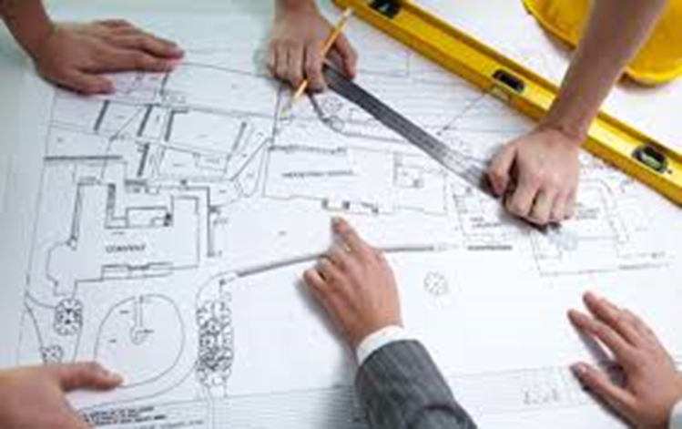
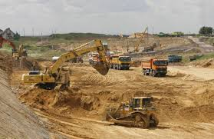
Research objects: eight investments
Average cost – 300 mln zl ≈ 70 mln €
Average duration – 3 years
Executed according to contract conditions "Yellow Book" FIDIC

Slide 6
Research method: review of the documentation
” the notice of claim”:
is prepared by the contractor and handed over to the contract engineer immediately after the contractor had become aware of the adverse event,
describes the adverse event,
the most valuable source of information about potential threats to the contract.

Slide 7
Results
226
“notices of claim” were identified basing on the documentation review

Slide 8
contractor’s claims
sources
internal factors
external factors
faulty design documentation
other conditions of execution than assumed (FD)
unforeseeable physical conditions / collisions or difficulties on the site (UC)
the lack of access to the construction site (LA)
fossils (FO)
changes in the primary requirements of the contracting authority
additional requirements of the contracting authority (AR)
adverse activities of third parties (TP)
alterations in legal regulations (LR)
prolonged approval or the lack of acceptance of the solutions submitted by the contractors (subcontractors) (PA)
Figure 1. Classification of factors underlying claims

Slide 9
Legend:
TP - adverse activities of third parties
UC - unforeseeable physical conditions
LR - alterations in legal regulations
FO - fossils
AR - additional requirements of the contracting authority
PA - prolonged approval of the contractors` solutions
FD - faulty design documentation
LA - the lack of access to the construction site
external factors
internal factors
Figure 2. The claims structure according to the factor causing them

Slide 10
Figure 3.The structure of the events that results in claims in the group of adverse activities done by third parties (TP)
third party - institutions such as authorities, offices, operators of infrastructure on the site, local community, owners of the plots on which the work is conducted.

Slide 11
Figure 4.The structure of the events results in claims in the group of unforeseeable physical conditions (UC)
unforeseeable physical conditions – natural physical conditions including manmade ones and other physical obstructions and pollutants, which the contractor encounters on the construction site when executing work.

Slide 12
Figure 5.The structure of the events that results in claims in the group of changes in legal regulations (LR)
alterations in legal regulations – changes in legal regulations of the country including the introduction of new laws and the repeal or modification of existing ones.

Slide 13
Alterations in legal regulations
The construction investment process is regulated by a number of legal acts - issues related to planning, design and construction of all type of facilities.
The neccessity to develop a lot of documents, submit relevant applications, appraisal reports or opinions in accordance with legal requirements.
any alterations in binding legal regulations or imposition of a new one may influence the course of the construction process

Slide 14
The number of legal acts passed on average per year in 2012-2014 – problem?
PROBLEM:
any legal regulation, may contribute to the delay in construction, additional costs or changes to the scope of the investment
Source: Own study based on http://barometrprawa.pl/

Slide 15
THE Impact of legal changes on the construction process
Questions in the survey
Did any alterations in legal regulations occur during the construction?
What was the effect of the alterations to legal regulations?

Slide 16
The impact of legal changes on the construction process
20% respondents indicated that alterations in legal regulations occur during their construction
Source: Own study

Slide 17
alterations in legal regulations
Possible cause of:
increase of the investment cost
extending the duration of the investment
nuisance for investors
changes in law:
→ a significant risk factor
→ have to be included in the project management
not only knowledge of the technical conditions of construction work, but also knowledge of the current legal status in a given country, is a prerequisite for the correct course of a construction project

Slide 18
External factor → the most frequent reason for a claim
third party
authorities, offices, operators of the infrastructure on the site, local community, owners of the plots
changes in legal regulations
regulation of company's operations, technical conditions, environmental protection, investment processes
unforeseeable physical conditions
over- and underground infrastructure, ground and water conditions, protected natural elements
Need to manage the claims so as to reduce their effects
extending the investment or exceeding planned budget

Slide 19
Discussion
The idea of the Claim Institution
or

